Slide 1

SMART INDIA HACKATHON 2026
KISAN SETU
Problem Statement ID – SIH26032
Problem Statement Title- Farmers often face long waiting times, lack of information regarding procurement schedules, and uncertainty about procurement status
Theme- Smart Automation
PS Category- Software
Team ID-
Team Name (AGRO CONNECT)

Slide 2
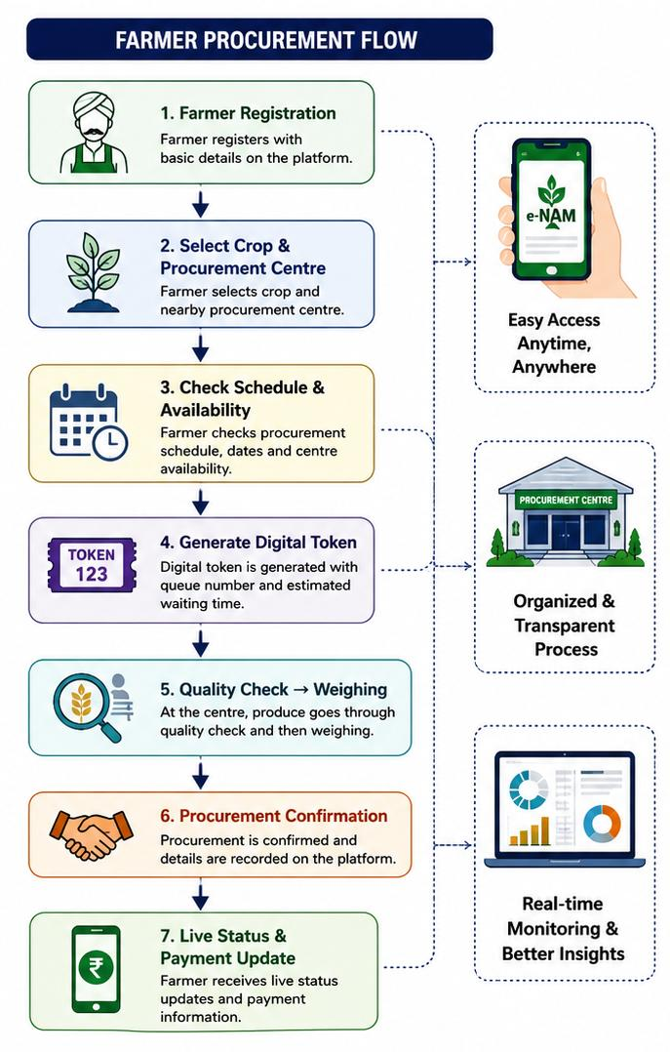
KISAN SETU
AGRO CONNECT
Proposed Solution
• Unified Farmer Procurement Platform - A web and mobile-based platform that provides farmers with a single place to access procurement schedules, nearby procurement centers and important updates.
• Digital Farmer Registration - Allows farmers to register their details and crop information digitally, reducing paperwork and simplifying the procurement process.
• Live Procurement Status - Provides real-time updates such as Registration → Waiting → Quality Check → Weighing → Procurement Completed → Payment Status, so farmers can track their produce.
• Smart Queue & Token System - Generates a digital token/queue number and provides an estimated waiting status, helping distribute farmer visits and reduce overcrowding at procurement centers.
• Notifications & Alerts - Sends alerts for procurement schedule changes, token updates, center availability and procurement/payment status through the platform.
• Procurement Centre Dashboard - A dashboard for officials to manage farmer registrations, tokens, procurement progress and center workload, improving coordination and transparency.

Slide 3
TECHNICAL APPROACH
AGRO CONNECT
QUERY / PROBLEM
SOLUTION FLOW
⏱
Long waiting & queues at procurement centres
1
Farmer
Registration
2
Crop & Document
Verification
3
Live Slot
Booking
4
Date + Time
Confirmation
📅
Date/time schedule is unclear
availability
instant confirmation
5
Centre Visit
& Token
6
Quality + Weight
Verification
7
Procurement
Accepted
8
Payment + Status
Tracking
📱
Verification, acceptance & payment status is hard to track
digital token
real-time status
🚜
Repeated visits waste farmer’s time and money
TECH STACK
Frontend: HTML,CSS • Backend: JAVASCRIPT(Node.js)
Database: PostgreSQL • Auth: JAVASCRIPT • Cloud: AWS
EXPECTED RESULT
Less waiting
+ fewer visits
+ transparent tracking
CORE IDEA: Book a verified procurement slot online → reach the centre on time → track acceptance & payment from one dashboard.

Slide 4
FEASIBILITY AND VIABILITY
AGRO CONNECT
1. Technically Feasible
2. Financially Viable
3. Useful for Farmers
• Uses simple mobile/web technology
• Can connect with procurement- centre updates
• SMS/IVR works when internet is weak
• Start with one centre, then expand
• Begin with a small pilot, keeping costs low
• Uses existing phones and centre computers
• Less repeated enquiry and manual follow-up
• Scale centre-by-centre as adoption grows
• Farmers know when to come
• They can see their queue/status
• Fewer wasted trips and waiting hours
• Clear updates build trust
Why this can succeed?
Start Small
Simple to Use
Low Extra Cost
Easy to Scale
“We are not replacing procurement — we are making it easier for farmers to understand and plan around it.”
1

Slide 5
IMPACT AND BENEFITS
AGRO CONNECT
Benefits of the solution
Benefits of the solution:
→ Social:
  Reduces farmer stress and builds trust in the procurement system.
  Ensures equal access to information for small and marginal farmers.
  Strengthens direct communication between farmers and procurement staff.
→ Economic:
  Cuts travel and time costs by reducing repeat visits to centers.
  Minimizes produce spoilage caused by long queue waiting times.
  Enables faster, predictable payments and improves farmer cash flow.
→ Educational:
  Builds farmer awareness of procurement policies and MSP schemes.
  Promotes digital literacy through simple app, SMS and IVR interactions.
  Shares crop-quality and procurement norms via in-app notifications.
→ Technological:
  Automates scheduling, replacing manual, paper-based coordination.
  Integrates with e-NAM and existing mandi management systems.
  Uses predictive analytics to forecast footfall and optimize capacity.
→ Environmental:
  Reduces paper-based tokens and manual record-keeping.
  Cuts travel emissions from repeated, uncertain farmer visits.
  Improves resource planning, minimizing produce wastage at centers.
Social
Economical
Educational
Technological
Environmental
Educational
S
₹
Ed
T
En
Potential impact on the target audience:
Reduced waiting time: automated slot booking and live queue updates let farmers plan their visit and cut down hours spent waiting at procurement centers.
Increased transparency: real-time alerts on the app, SMS and dashboard keep farmers informed about schedules and the status of their produce at every stage.
Better financial planning: predictable timelines and instant payment-status updates reduce distress sales and help farmers plan household and farm expenses.
Wider accessibility: multi-channel access in regional languages through app, SMS and IVR ensures small, marginal and low-literacy farmers benefit equally
@SIH Idea submission- Template
5

Slide 6
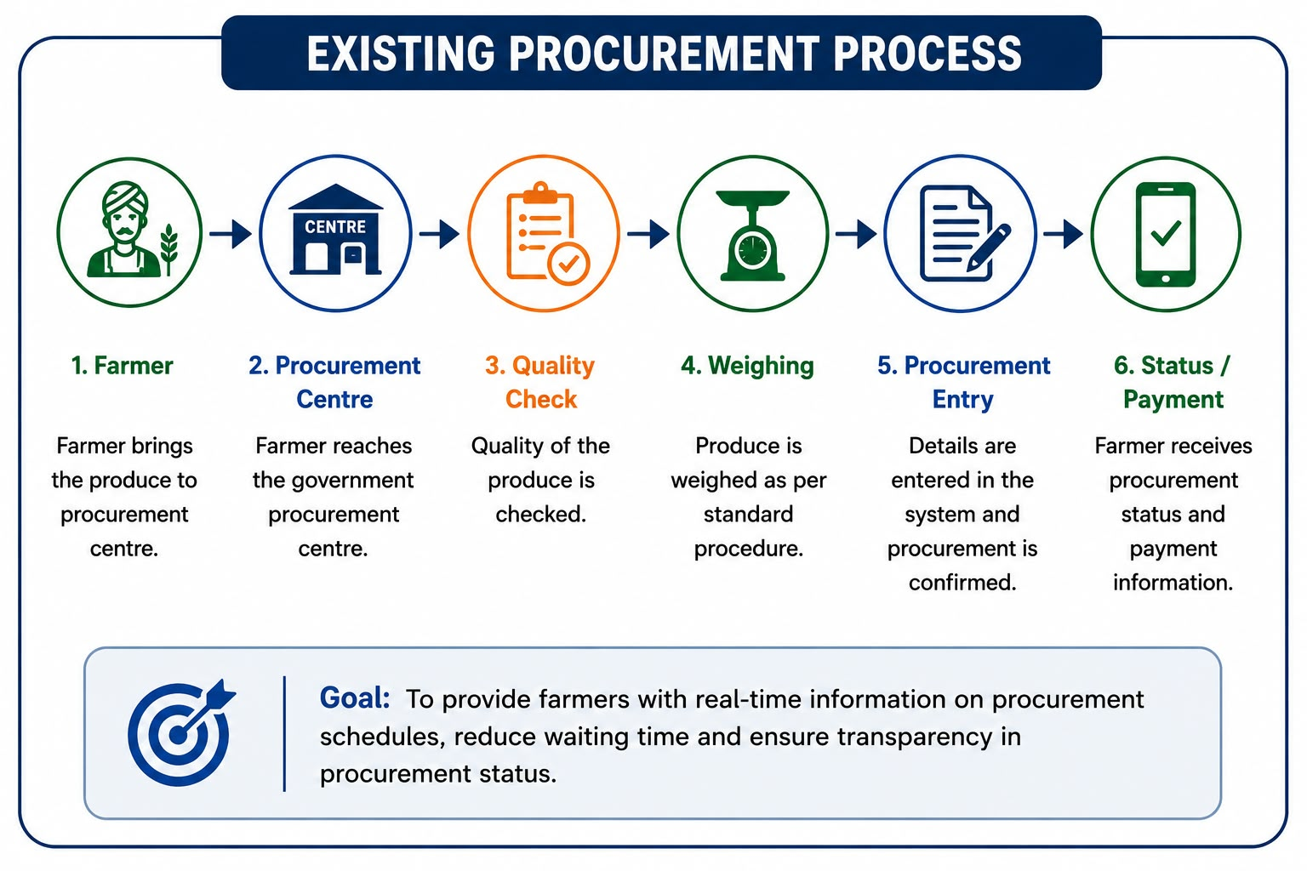
RESEARCH AND REFERENCES
AGRO CONNECT
REFERENCES :-
1. e-NAM – National Agriculture Market
https://enam.gov.in/
2. Department of Food & Public Distribution (DFPD)
https://dfpd.gov.in/
3. Government Procurement Policy Wheat & Rice
https://dfpd.gov.in/procurement-policy/en
RESEARCH & BEST PRACTICES :-
e-NAM Farmers Module https://www.enam.gov.in/web/mobile-app/farmers-module
2. e-NAM Registration Guidelines https://enam.gov.in/web/resources/registration-guideline
3. Foodgrain Procurement System https://dfpd.gov.in/faqs/en
4. Digital Lot Tracking https://www.enam.gov.in/web/stakeholders-Involved/farmers
@SIH Idea submission- Template
6

